Slide 1
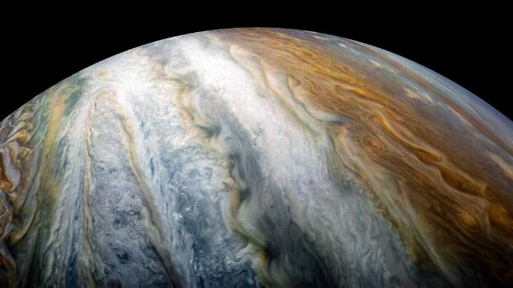
Notebooks in Azure Data Studio for the DBA

Slide 2
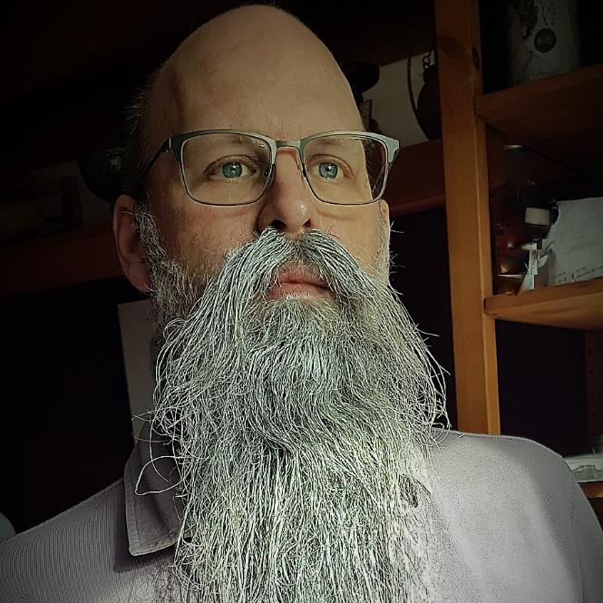
Rob Sewell
Consultant
MVP and Beard Twizzler
@SqlDbaWithBeard
beard.media/book – 40 % code twitsewe40

Slide 3
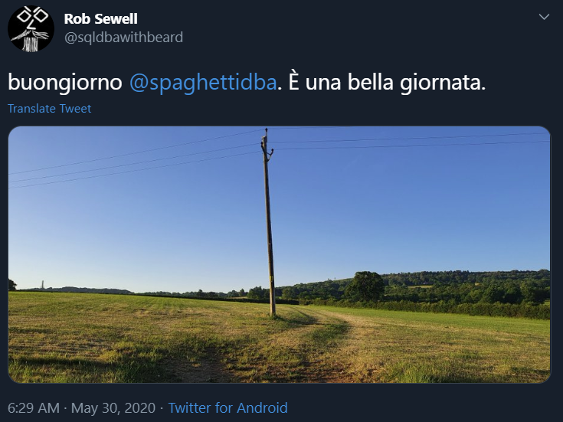
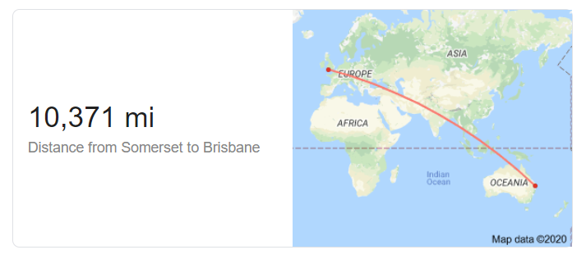
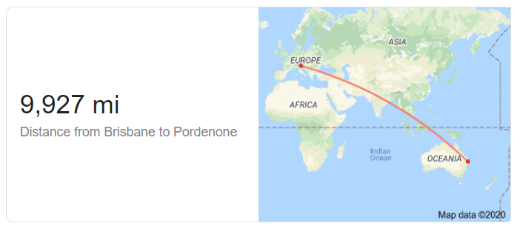
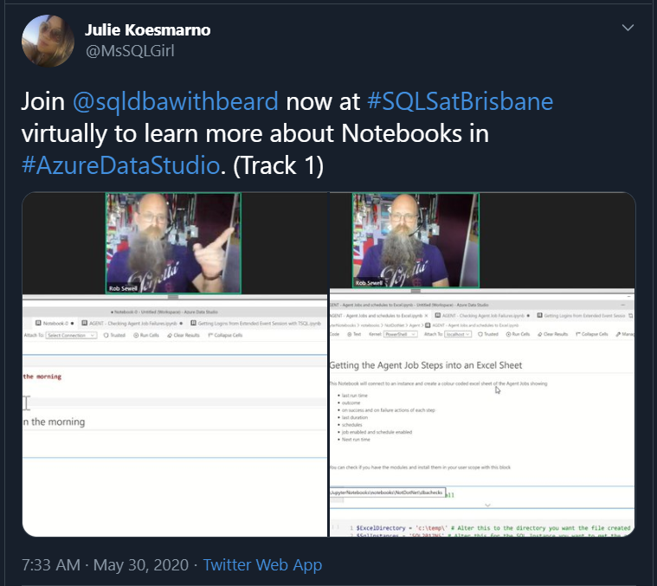

Slide 4








Explore your PASS community
Own your career with interactive learning built by community and guided by data experts.
Get involved. Get ahead.
Free online webinar events
Local user groups around the world
Connect with the global data community
.org
Online special interest user groups
Learning on-demand and delivered to you
Get involved

Slide 5
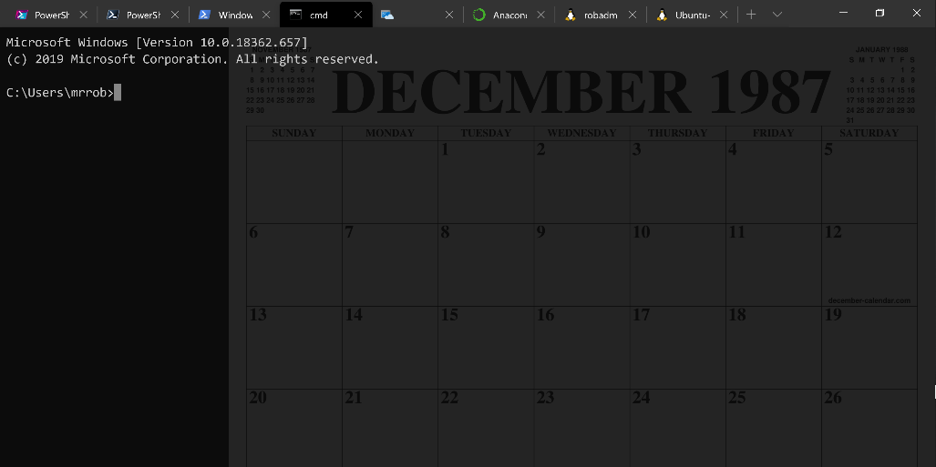
Running Queries
@SQLDBAWithBeard SqlDbaWithABeard.com Rob Sewell beard.media/book

Slide 6
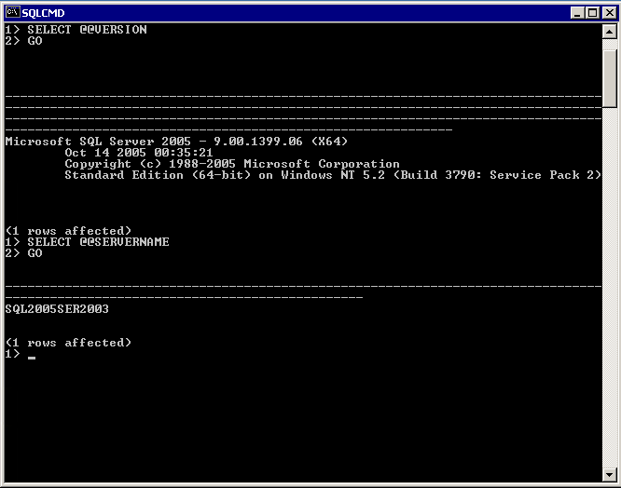
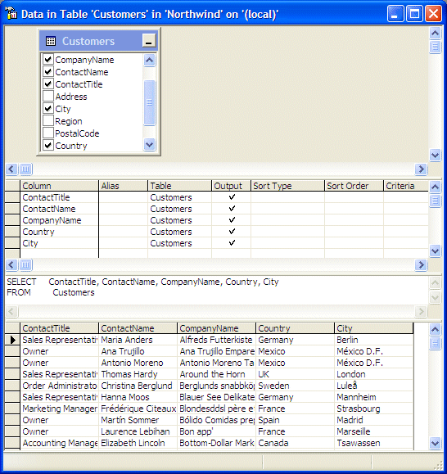
@SQLDBAWithBeard SqlDbaWithABeard.com Rob Sewell beard.media/book

Slide 7
Two and a Half Decades

Slide 8
Uh, Houston, we've had a problem
https://en.wikipedia.org/wiki/Houston,_we_have_a_problem
@SQLDBAWithBeard SqlDbaWithABeard.com Rob Sewell beard.media/book

Slide 9
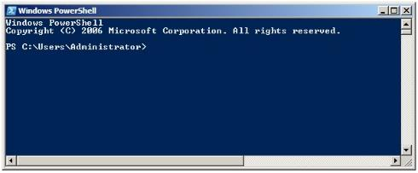
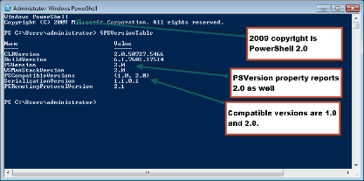
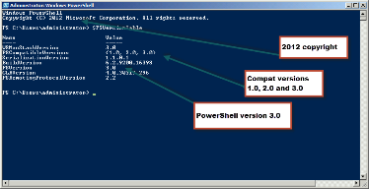
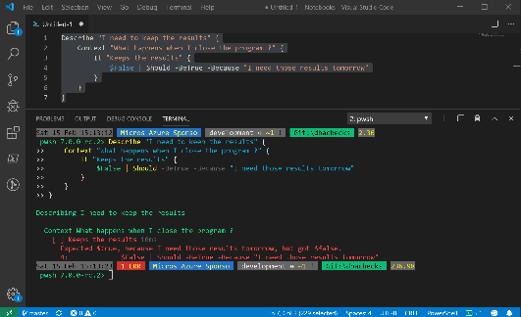
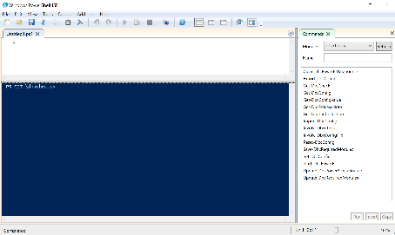
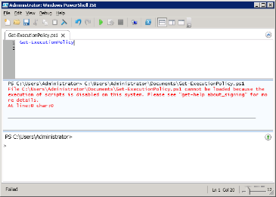
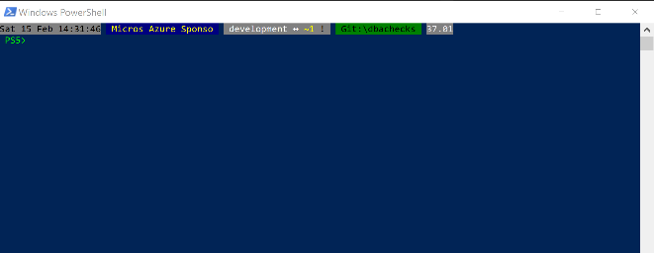
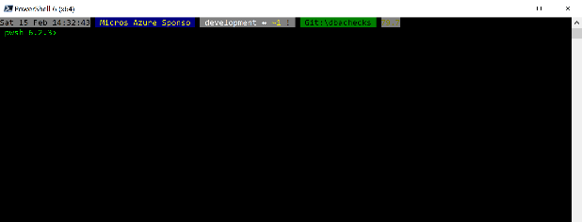
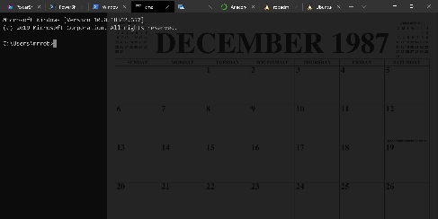
Without some effort………..

Slide 10
Without some effort………..
@SQLDBAWithBeard SqlDbaWithABeard.com Rob Sewell beard.media/book

Slide 11
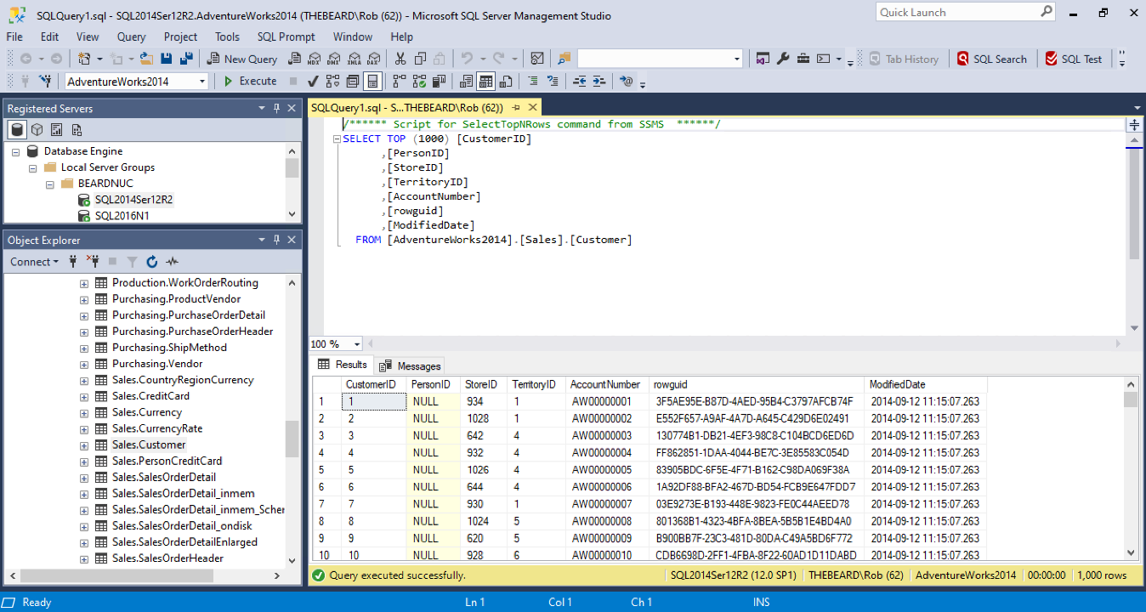

Slide 12
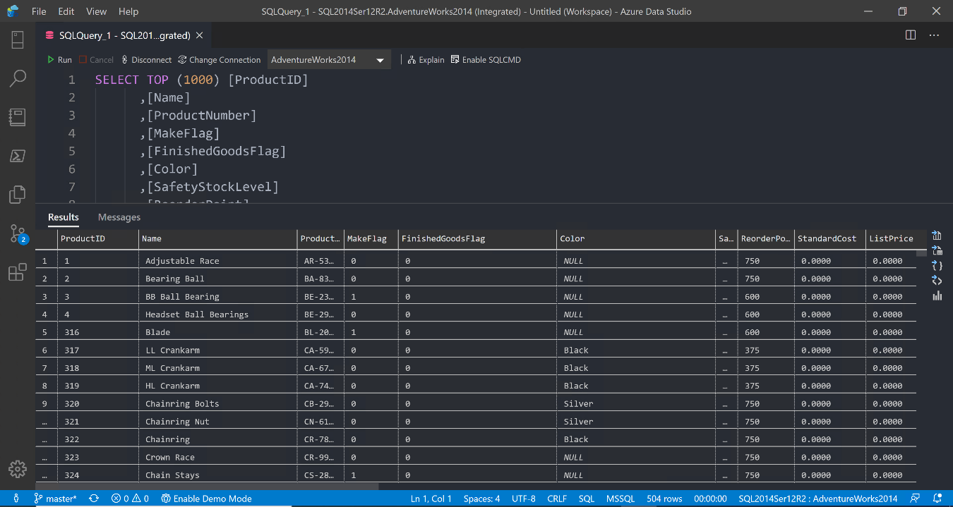

Slide 13
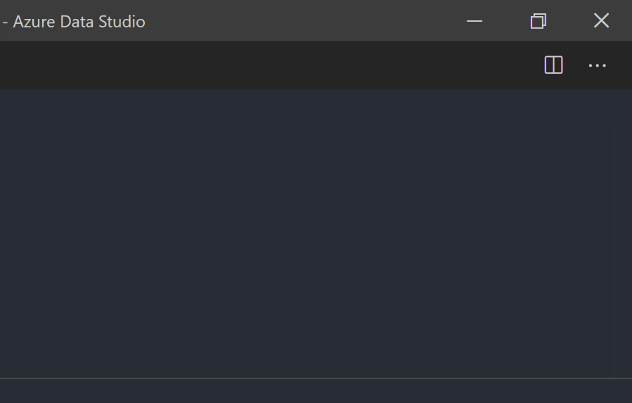
@SQLDBAWithBeard SqlDbaWithABeard.com Rob Sewell beard.media/book

Slide 14
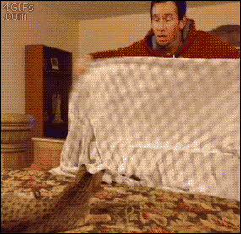
@SQLDBAWithBeard SqlDbaWithABeard.com Rob Sewell beard.media/book

Slide 15

@SQLDBAWithBeard SqlDbaWithABeard.com Rob Sewell beard.media/book

Slide 16
ALL
GONE
@SQLDBAWithBeard SqlDbaWithABeard.com Rob Sewell beard.media/book

Slide 17
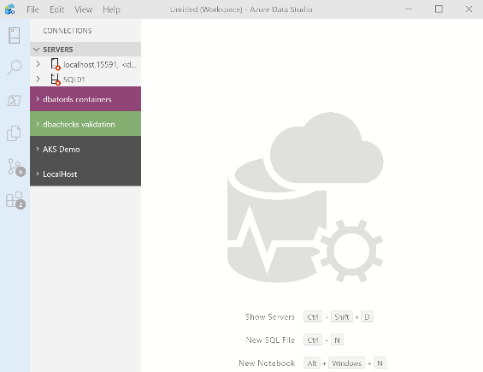
What’s Azure Data Studio ?
Cross Platform desktop environment for Data Professionals
@SQLDBAWithBeard SqlDbaWithABeard.com Rob Sewell beard.media/book

Slide 18








Thank you to our Local Sponsors and Supporters

Slide 19

So it’s only for Azure?
@SQLDBAWithBeard SqlDbaWithABeard.com Rob Sewell beard.media/book

Slide 20
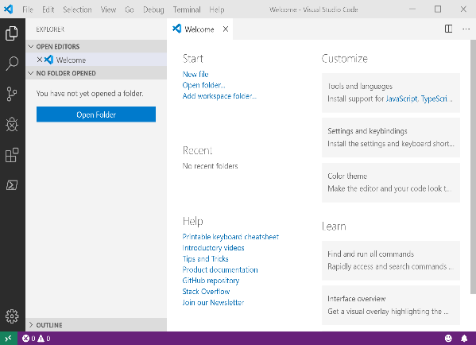
It Looks Like Visual Studio Code ?
@SQLDBAWithBeard SqlDbaWithABeard.com Rob Sewell beard.media/book

Slide 21
It Looks Like Visual Studio Code ?
@SQLDBAWithBeard SqlDbaWithABeard.com Rob Sewell beard.media/book

Slide 22


Slide 23
Jupyter

Slide 24
Jupyter
First, the name comes from the planet Jupiter. We wanted to pick a name that evoked the traditions and ideas of science.
https://github.com/jupyter/design/wiki/Jupyter-Logo

Slide 25
Jupyter
Second, the core programming languages supported by Jupyter are
Julia, Python and R.
While the name Jupyter is not a direct acronym for these languages, it nods its head in those directions.
In particular, the "y" in the middle of Jupyter was chosen to honor our Python heritage.
https://github.com/jupyter/design/wiki/Jupyter-Logo

Slide 26
Jupyter
Third, Galileo was the first person to discover the moons of Jupiter. His publication on the moons of Jupiter is an early example of research that includes the underlying data in the publication.
This is one of the core ideas and requirements for scientific reproducibility.
Reproducibility is one of the main focuses of our project.
https://github.com/jupyter/design/wiki/Jupyter-Logo

Slide 27





Thank you to our Global Sponsors

Slide 28
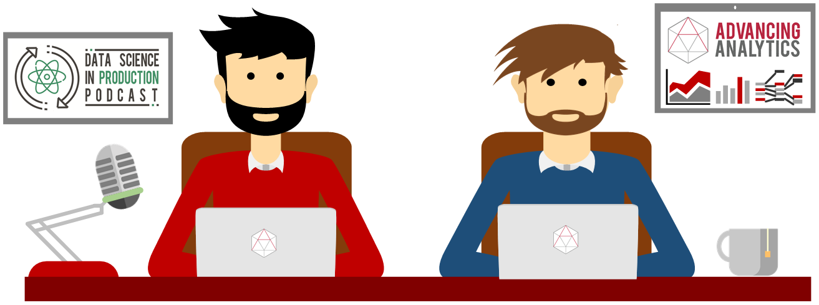
What is a Jupyter Notebook?
Originally for Data Scientists

Slide 29
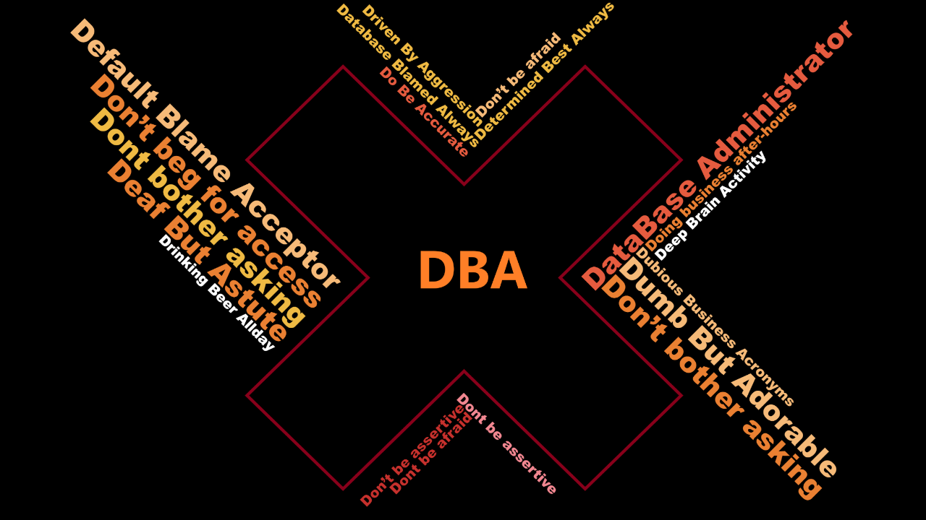

Slide 30
Document that can contain text, code, images and query results

Slide 31
PowerShell Conference EU
All the videos for the Virtual European PowerShell conference have been uploaded and are available for your viewing please at
PowerShell.love

Slide 32

Time For A DEMO

Slide 33
Ricordatevi di compilate il feedback form ☺
https://speakerscore.com/7QK2
#SqlSat921

Slide 34

Missed PASS Summit 2019?
Get the Recordings
Download all PASS Summit sessions on Data Management, Analytics, or Architecture for only $399 USD
More options available at PASSstuff.com

Slide 35

We are covering all bases to ensure our community can continue reaching new and exciting heights. Plans are underway for the in-person event you all know and love along with a new venture, a new opportunity: a PASS Summit 2020 Virtual Event.
Find out more at PASS.org/summit

